Slide 1
Can a goat wear a coat?

Slide 2
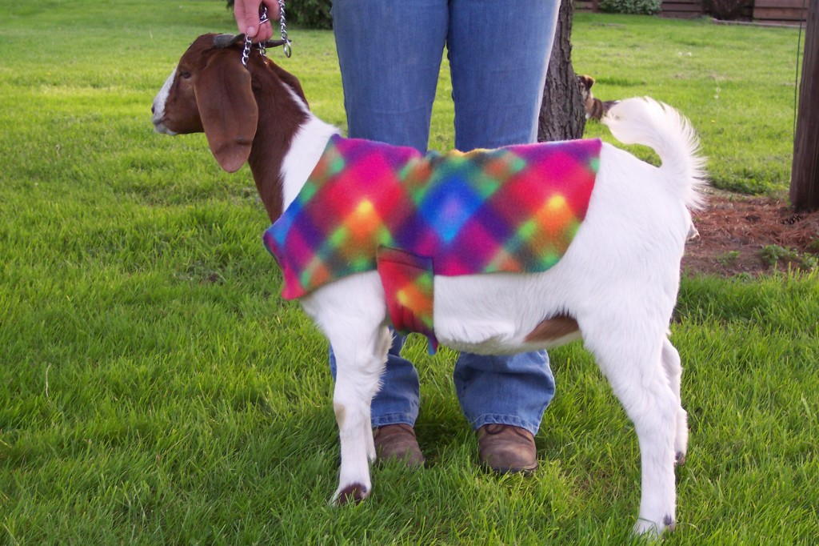
Can a goat wear a coat?

Slide 3
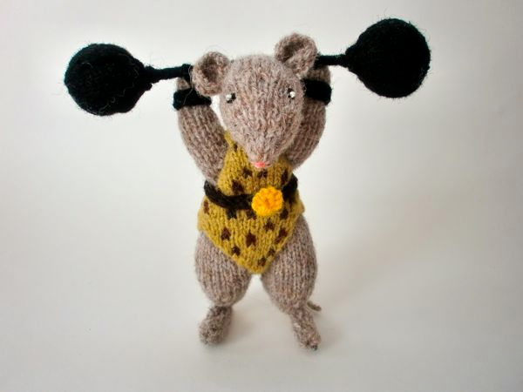
Can a mouse lift a house?

Slide 4
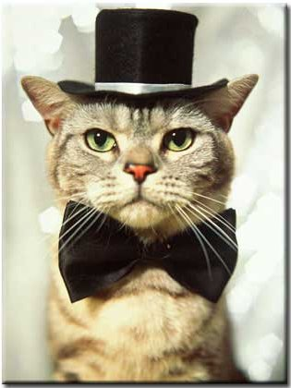
Can a cat wear a hat?

Slide 5
Can a duck drive a truck?

Slide 6
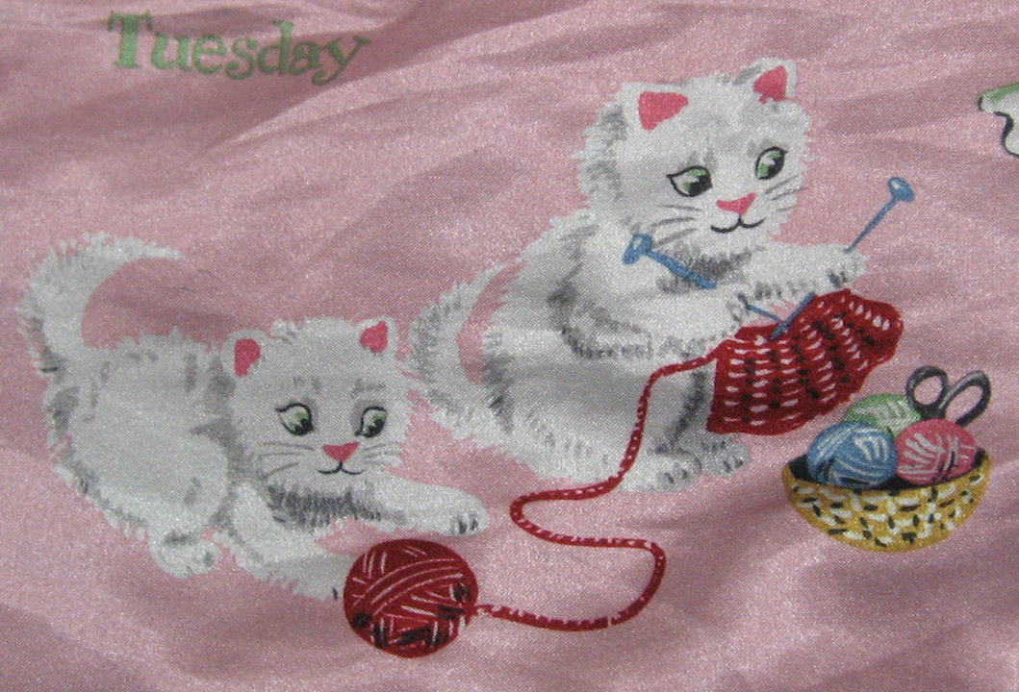
Can a kitten knit a mitten?

Slide 7
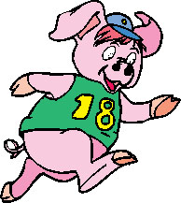
Can a hog learn to jog?

Slide 8
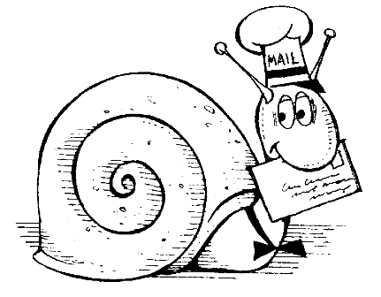
Can a snail get mail?

